Slide 1
“Life is a series of samples. You can infer the truth from the samples, but you never see the truth.”
--Kenji, 2010
Educ 200C
Friday, October 5, 2012

Slide 2
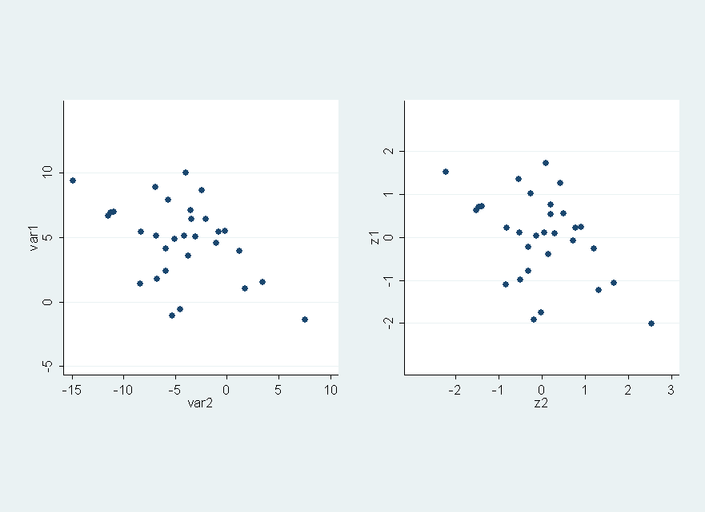
Correlation
Correlation is used to describe how two variables vary with each other

Slide 3
The correlation value gives us a sense of how variables move in relation to one another. The correlation ranges from -1 to 1. Positive correlations are like attractive magnets: as one variable moves up or down, it tugs the other value in the same direction. Negative correlations are like repulsive, same-pole magnets: as one variable increases, it pushes the other variable farther away from it.
The first thing to note is the sign of the correlation value. A positive correlation of 0.69 indicates that as math scores increase, reading scores will also increase (think of the attracting magnets). If the correlation value was -0.69, this would move the other way: higher match scores would tend to pair up with lower reading scores in a given student.
0.69 is also a fairly high correlation value. This gives us a sense that we can make fairly reliable predictions about a second variable if we know the first. The closer the correlation value is to 0, the less reliably we can predict one variable from another. In this case, given a student's math score, we could predict his/her reading score with fair reliability.

Slide 4
  If the correlation between math and reading scores is .69, then if a math score for a student is 1 standard deviation above the mean, then we predict her reading score will be .69 above from the mean.
  If you know a student’s math score, then r gives you a predicted reading z-score, and if you know the mean and standard deviation for the reading test, you can work backwards to get the raw test score.

Slide 5
Pearson r correlation coefficient:
There are 3 mathematically equivalent formulas (we can prove if you like). Just pick your favorite:
    Z-score difference formula
    Z-score product formula
    Raw score formula

Slide 6
Scatterplots
http://www.webster.edu/~woolflm/correlation/correlation.html

Slide 7
Correlation does not mean Causation!
Even if drinking and GPA are correlated, we do not know if people drink more because their GPA is low (drink to alleviate stress) or if drinking causes one’s GPA to be low (less study time) or neither of these.
There is always a chance that the variation in both variables is dues to some third variable.
  In Oldenburg, Germany, the correlation between number of storks sited and the population of Oldenburg from1930-1936 was r=0.95.
    Storks do not cause babies
    Babies do not cause storks
    What could be the third variable that causes both?

Slide 8
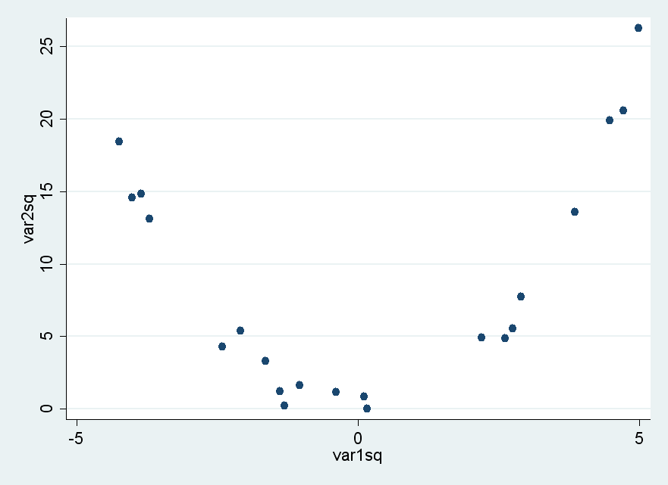
Correlation is only good for linear data
Always plot your data! Correlation is excellent and revealing linear relationships, but you can calculate a close to zero correlation with highly related data

Slide 9
Scatterplots in Excel

Slide 10
Questions?

